Slide 1
Gradient-Based Edge Detection and Enhancement
An Introduction to Signal Processing with Gradient-Based Edge Detection and Enhancement

Slide 2
What are Edges in Images?
• Edges are significant changes in pixel intensity
• They represent boundaries between objects
• Key features for:
- Object detection
- Image segmentation
- Pattern recognition
• Found where brightness changes sharply

Slide 3
Understanding Gradients in Images
• Gradients measure rate of intensity change
• Two components:
- Magnitude (strength of edge)
- Direction (orientation of edge)
• Calculated using Sobel operator:
• Understanding gradients is fundamental in image processing, particularly for tasks such as edge detection, feature extraction, and image segmentation. By analyzing gradients, we can gain valuable insights into the structure and content of images.

Slide 4
How Program Works
Step 1: Load Grayscale Image
Step 2: Apply Gaussian Smoothing
Step 3: Compute Image Gradients
Step 4: Enhance Edge Features
Step 5: Calculate PSNR (Peak Signal-to-Noise Ratio)
Step 6: Visualize Results

Slide 5
• Converting image to grayscale: • Applying Gaussian Filter for smoothing and noise reduction:
-A color photo contains a lot of information. Just like summarizing a text, We also simplify the image. Each pixel is a black-and-white into value.
-Gaussian Smoothing Filter is a technique used in image processing to reduce noise and detail in an image. It involves convolving the image with a Gaussian function, which results in a blurred effect. This process helps in enhancing the important features of the image while minimizing the impact of noise, making it easier to detect edges in subsequent steps.
- The primary reason for applying Gaussian smoothing is to prepare the image for edge detection. Noise in the image can lead to false edges being detected, which can complicate the analysis. By smoothing the image, I aimed to:
Enhance Edge Detection: Reducing noise allows for clearer and more accurate edge detection in the next steps of the process.
Improve Image Quality: Smoothing helps in creating a cleaner image that highlights the significant features, making it easier to analyze and interpret the results.

Slide 6
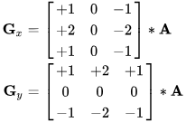
• Computing Image Gradients
-Computing Image Gradients is a fundamental step in image processing that helps identify edges within an image. Gradients measure the change in intensity at each pixel, indicating where significant transitions occur. By calculating the gradients in both the horizontal and vertical directions, we can determine the strength and direction of edges, which are crucial for further image analysis.
- The primary purpose of computing image gradients is to detect edges, which are critical features in image analysis. Edges often correspond to significant changes in intensity, such as the boundaries of objects within an image. By calculating the gradients, I aimed to:
Identify Edges: The gradient magnitude highlights areas of high intensity change, allowing for the detection of edges that define the structure of objects in the image.
Provide Directional Information: The gradient direction helps in understanding the orientation of edges, which can be useful for further processing tasks, such as shape recognition or object detection.

Slide 7
• Enhancing Edge Features
- Enhancing Edge Features is a critical step in image processing that aims to improve the visibility and clarity of edges detected in an image. This process typically involves applying thresholding techniques to distinguish between strong and weak edges, allowing for a more accurate representation of the significant features in the image. By enhancing edge features, we can reduce noise and improve the overall quality of edge detection. By applying Otsu's thresholding, I aimed to:
Distinguish Strong Edges: This method effectively separates significant edges from noise, ensuring that only the most relevant features are retained for analysis.
Simplify Further Processing: A clearer representation of edges allows for easier interpretation and analysis in subsequent steps, such as shape recognition or object detection.
Improve Image Quality: Enhancing edge features contributes to a cleaner and more interpretable output, which is essential for any image processing application.

Slide 8
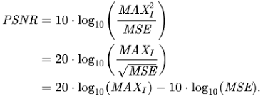
• Calculating PSNR (Peak Signal-to-Noise Ratio)
- Peak Signal-to-Noise Ratio (PSNR) is a widely used metric in image processing that measures the quality of a reconstructed or processed image compared to the original. It quantifies the ratio between the maximum possible power of a signal (the original image) and the power of corrupting noise (the differences between the original and processed images). A higher PSNR value indicates better image quality, meaning the processed image closely resembles the original.
The primary purpose of calculating PSNR is to objectively assess the quality of the edge detection process. By comparing the processed image with the original, I aimed to:
Evaluate Performance: PSNR provides a quantitative measure of how well the edge detection algorithm performed. A higher PSNR indicates that the edges detected are more accurate and closely resemble the true edges in the original image

Slide 9
Results and Visual Examples
Demonstration of the effectiveness of the approach

Slide 10
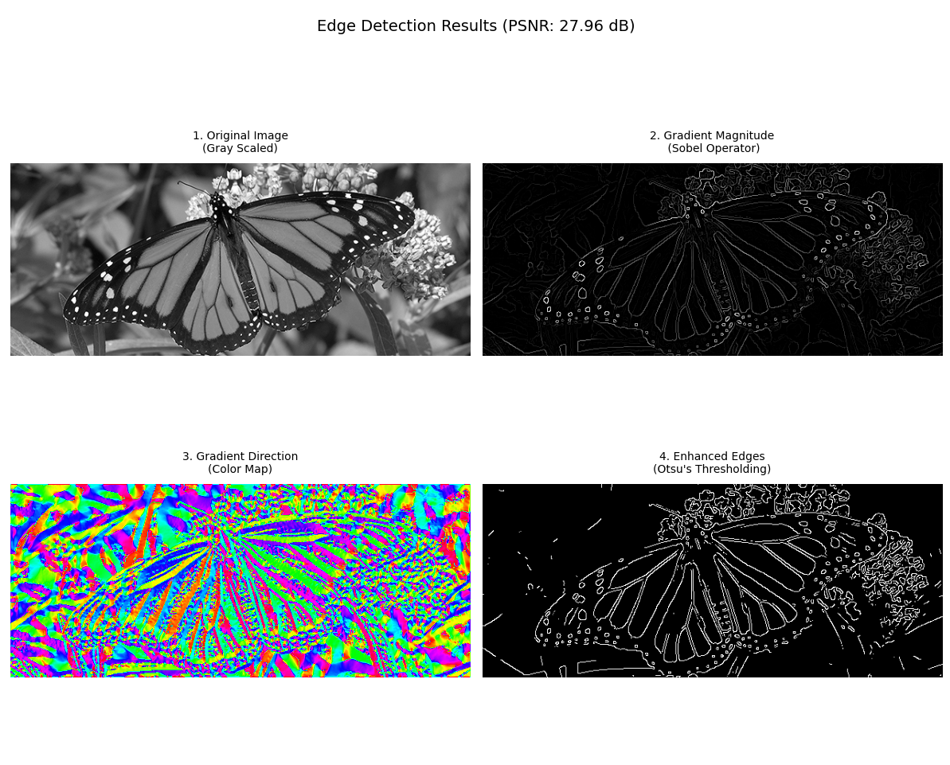
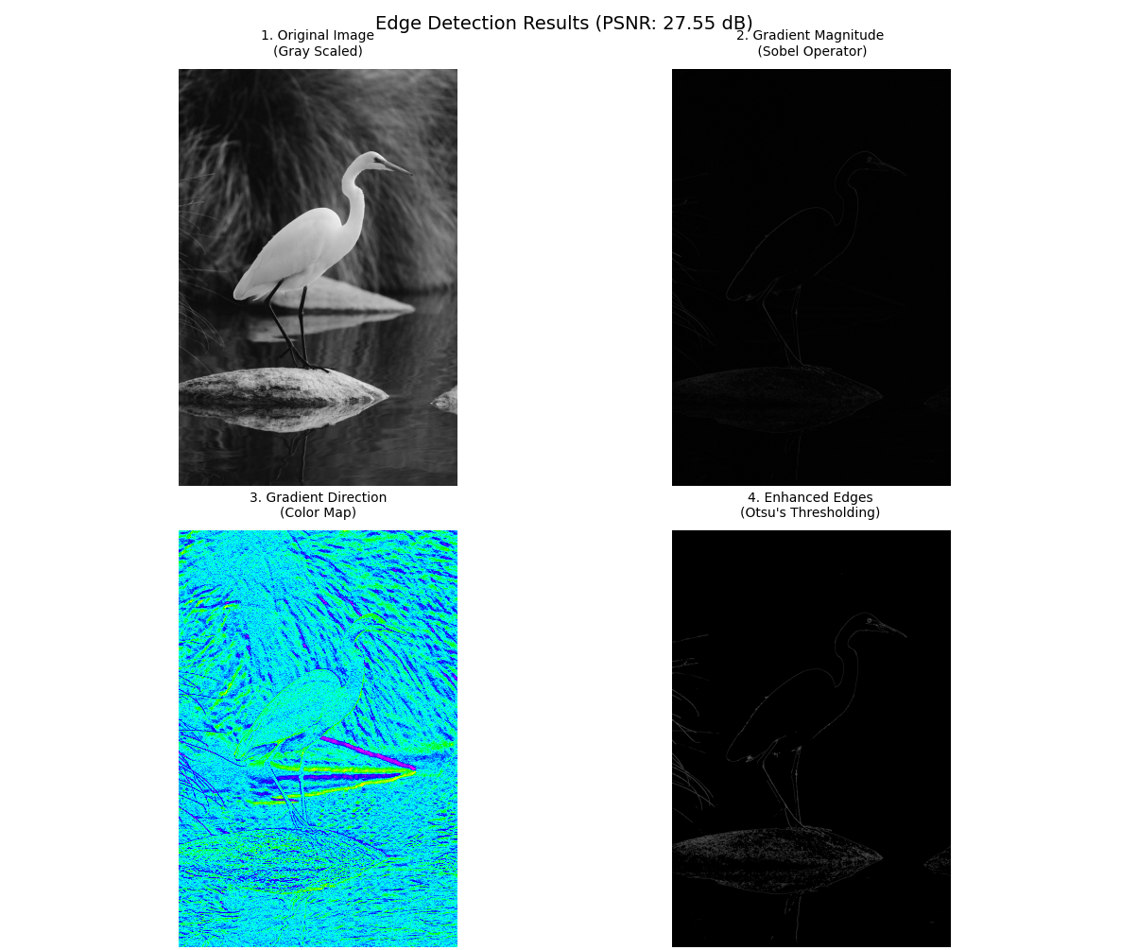
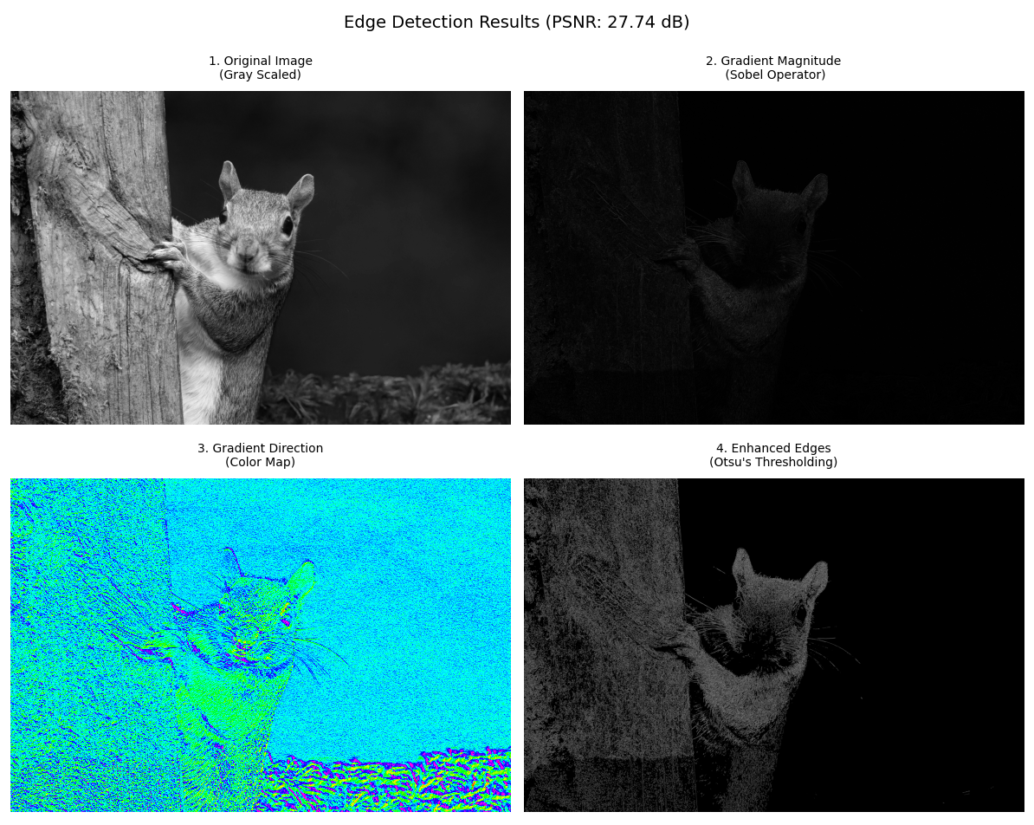
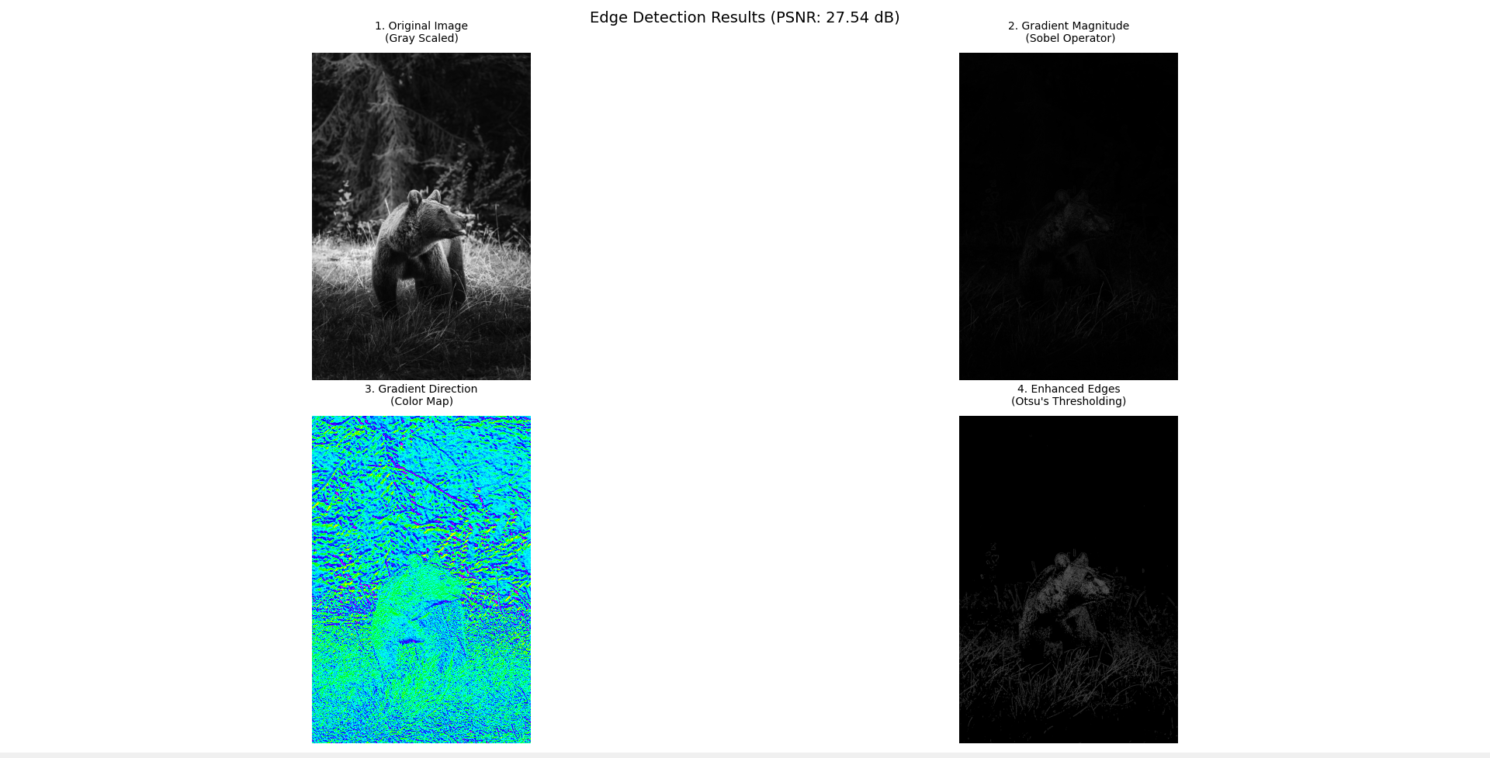

Slide 11
Practical Applications
Industrial Applications
Research Applications
• Quality control
• Defect detection
• Pattern matching
• Robot vision
• Medical imaging
• Satellite imagery
• Document processing
• Face detection

Slide 12
Summary and References
• Successful implementation of gradient-based edge detection
• Key features:
- Automatic threshold determination with Otsu
- Sobel gradient operator
- Noise reduction
•References:
-https://en.wikipedia.org/
- https://unsplash.com/
- https://github.com/snijesh/edge-detection
- https://handmap.github.io/gradients-and-edge-detection

